Slide 1
Embedded System
Notes:
Welcome back! I hope you had a good time with Brian getting your TinyML board setup and ready to go!
In this section, I am going to be a bit pedagogical in the sense that I want to explain how we arrived at the system you are holding in your hand.
I want you to understand how this tiny embedded system corresponds to the real world, because one of my goals is to make sure you are equipped with the right essentials that will enable to you progress beyond the course.
So lets get started

Slide 2
System Elements
We start with a simple question: what is an embedded system?
analog
digital
analog
sense
(input)
process
actuate
(output)
phenomenon
Why embedded? definition: “(adj) fixed firmly and deeply in a surrounding mass; implanted.”
Notes:
Recall what is an embedded system.
You’ve got a set of inputs, you do some on-device compute, and you actuate a physical subsystem
The inputs are analog, process is digital, output is analog (though sometimes it can also be digital)

Slide 3
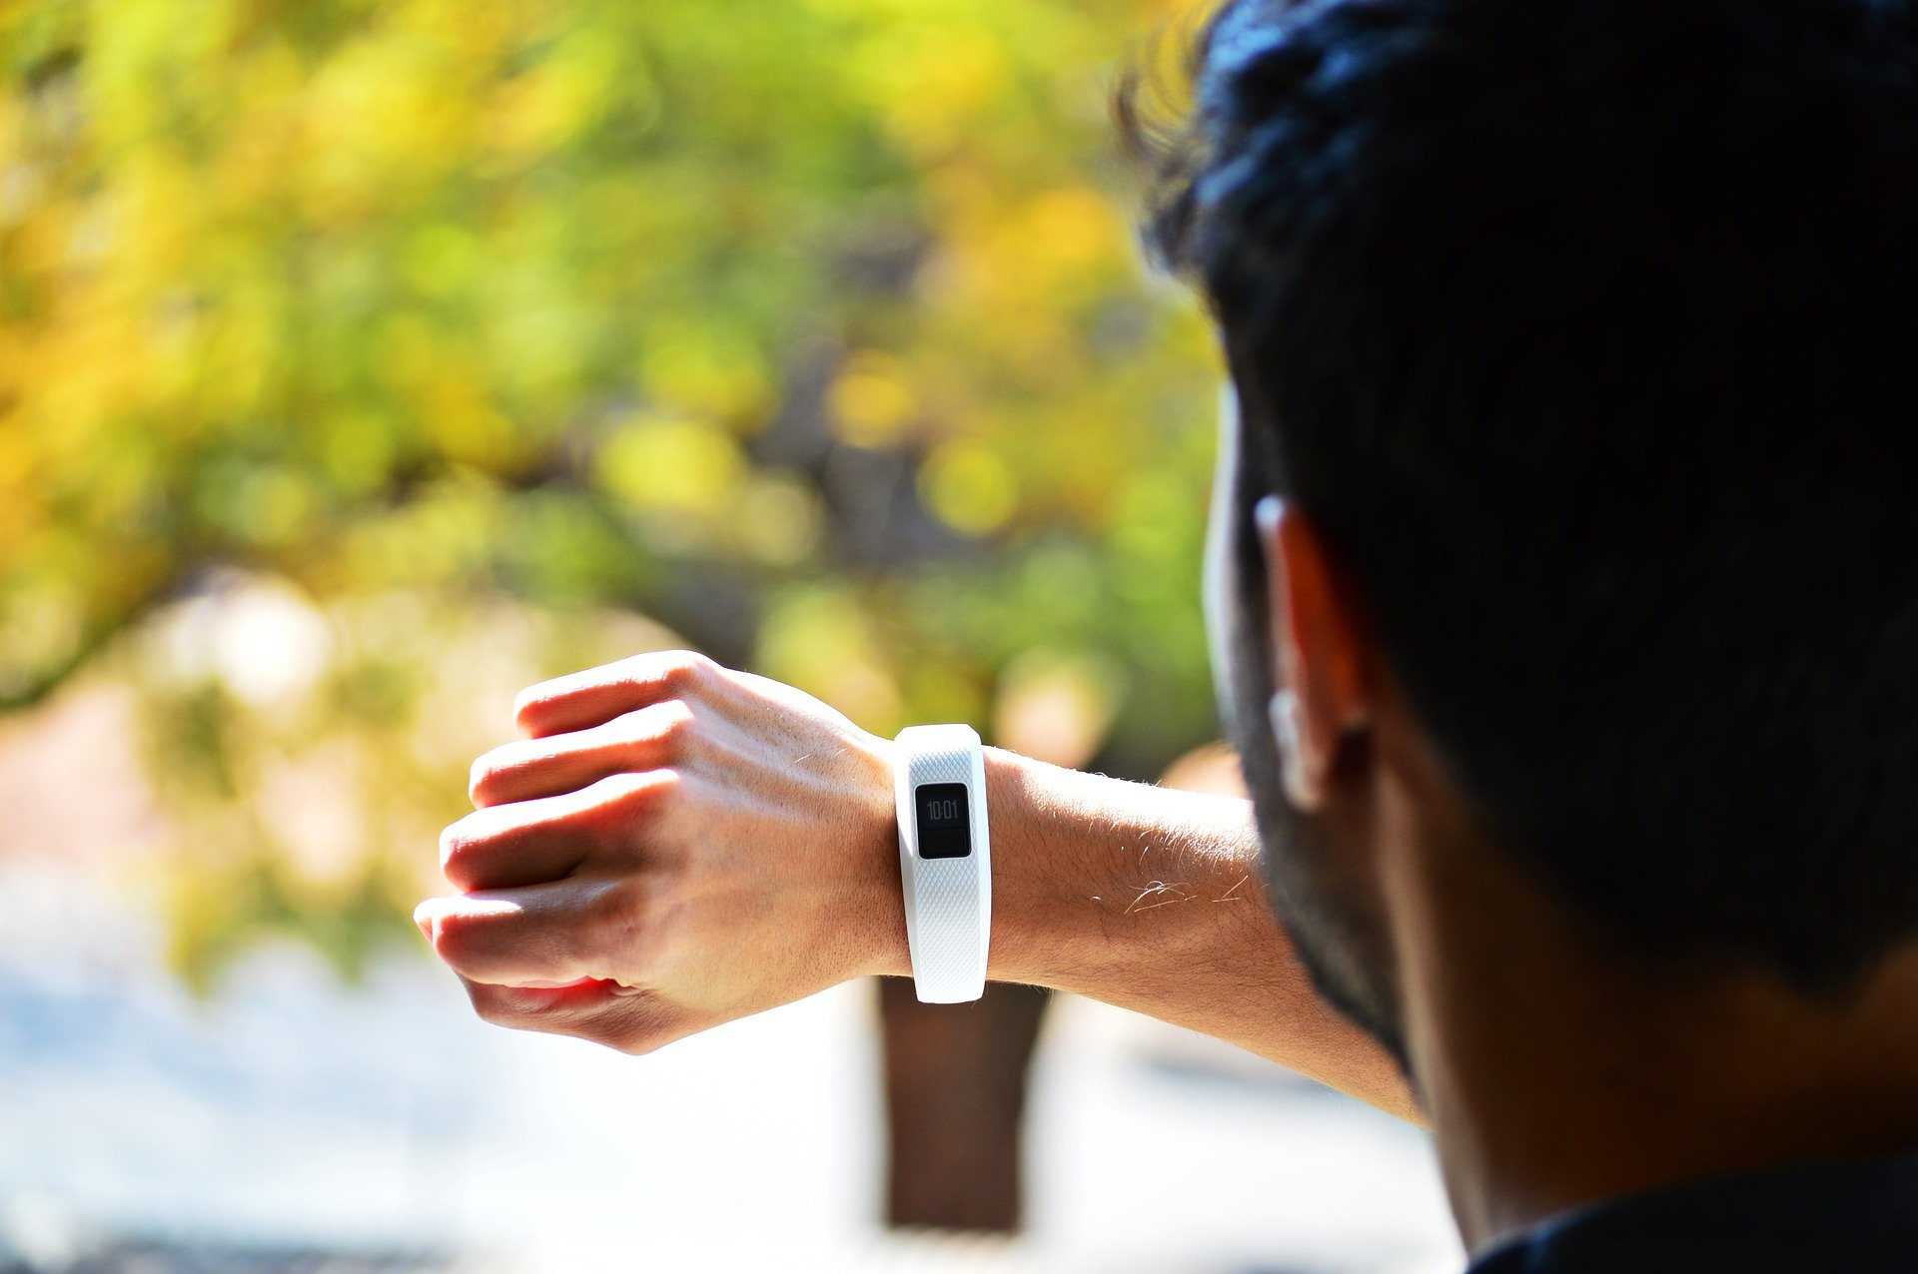
Notes:
Examples of such embedded systems obviously include devices like the …
Fitbit
Sense - temperature, rotation
Process - user input, routines
Act - AC, screen, sound
https://pixabay.com/photos/tracker-fitness-health-exercise-3735862/

Slide 4
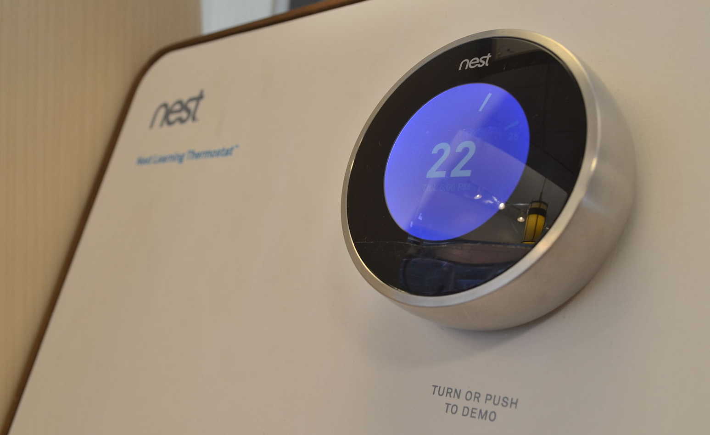
Notes:
Or perhaps your nest thermostat… I have 7 of these in my house
Sense - temperature, rotation
Process - user input, routines
Act - AC, screen, sound
https://commons.wikimedia.org/wiki/File:NestLearningThermostat3.JPG

Slide 5
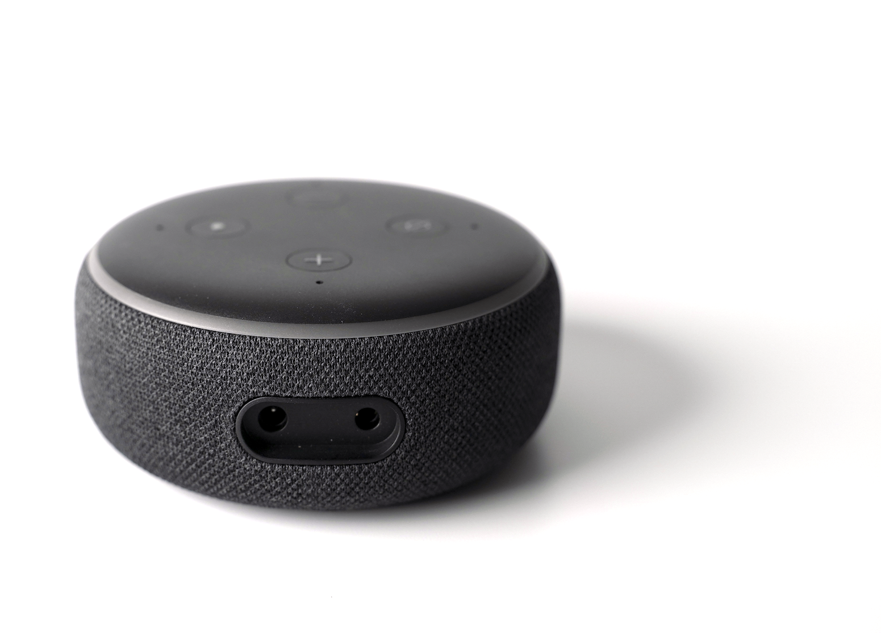
Notes:
So lets take one of these devices and deconstruct it down
This is a real echo dot, one that you can buy off the shelf at a store
… cause i want to make the connection between this device and what’s in a production grade device.

Slide 6
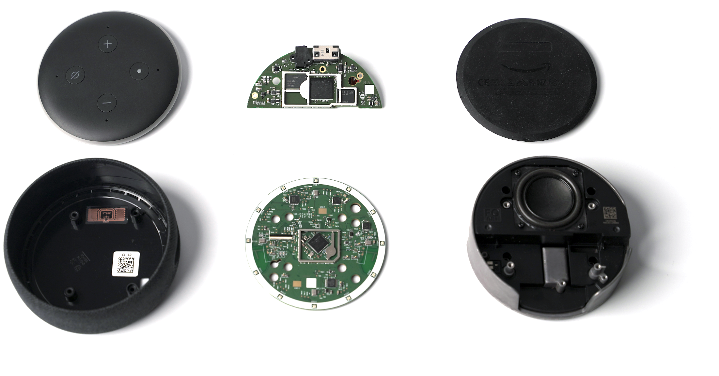
Notes:
Deconstrcut it down, you’ll see that we’ve got lots of components

Slide 7
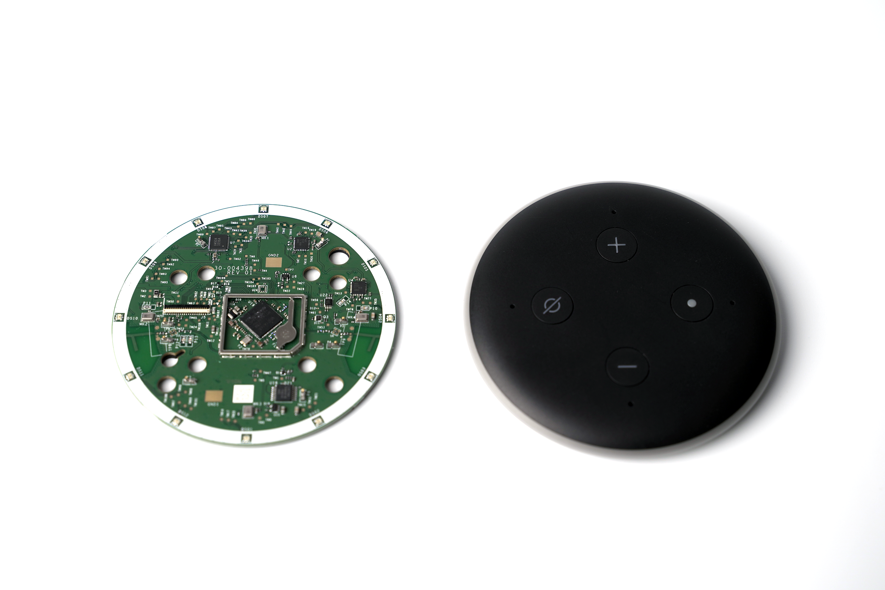
sense
(input)
Notes:
4 mic array with Texas Instruments ADC
Info: https://www.briandorey.com/post/echo-dot-3rd-gen-smart-speaker-teardown

Slide 8
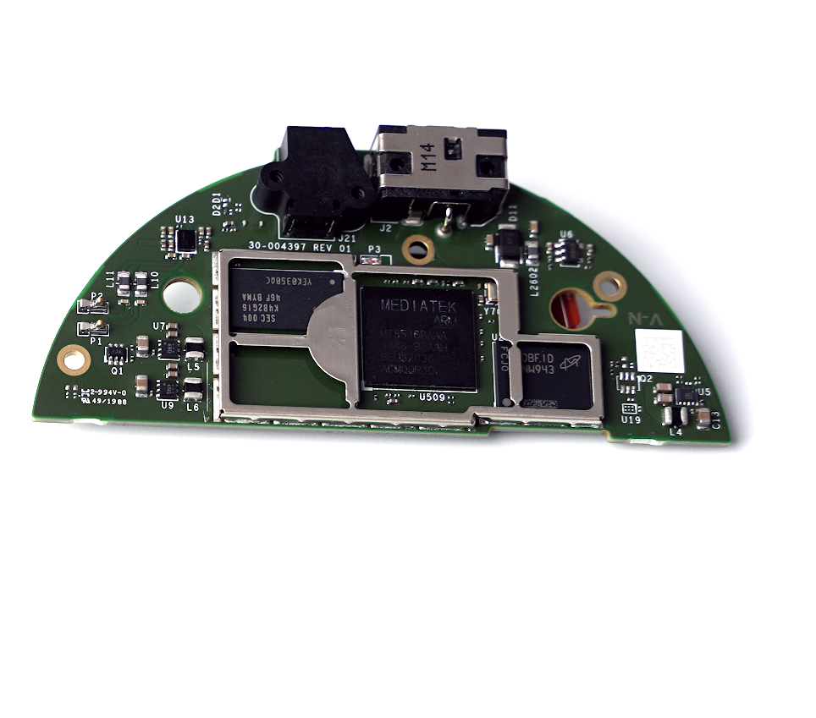
process

Slide 9
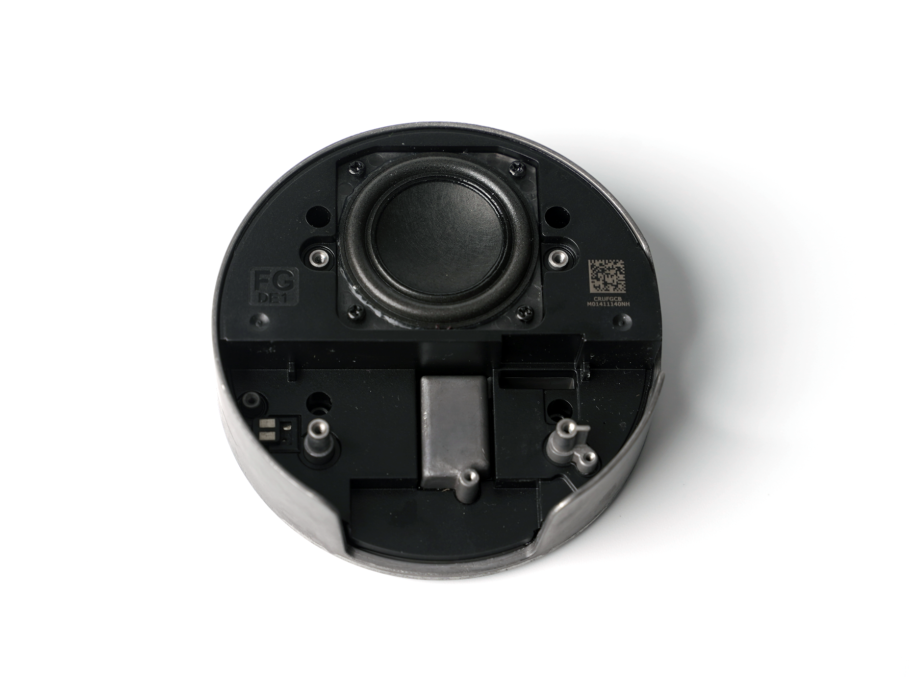
actuate
(output)

Slide 10
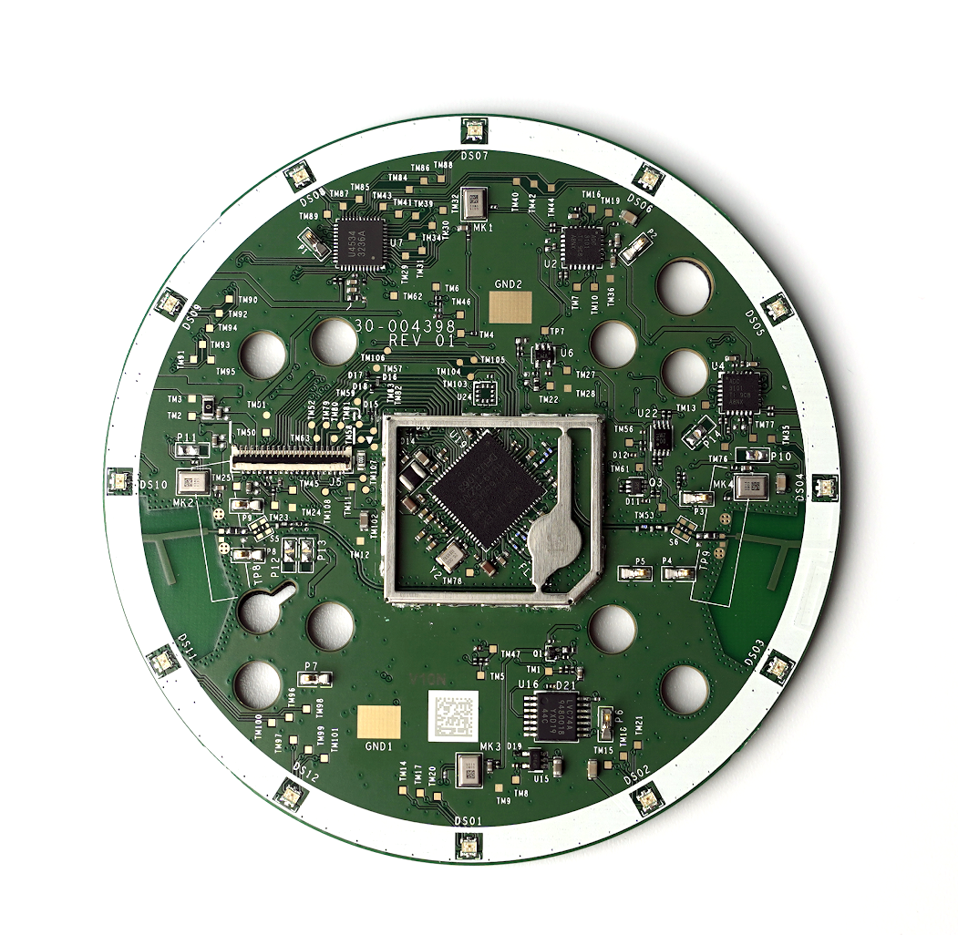
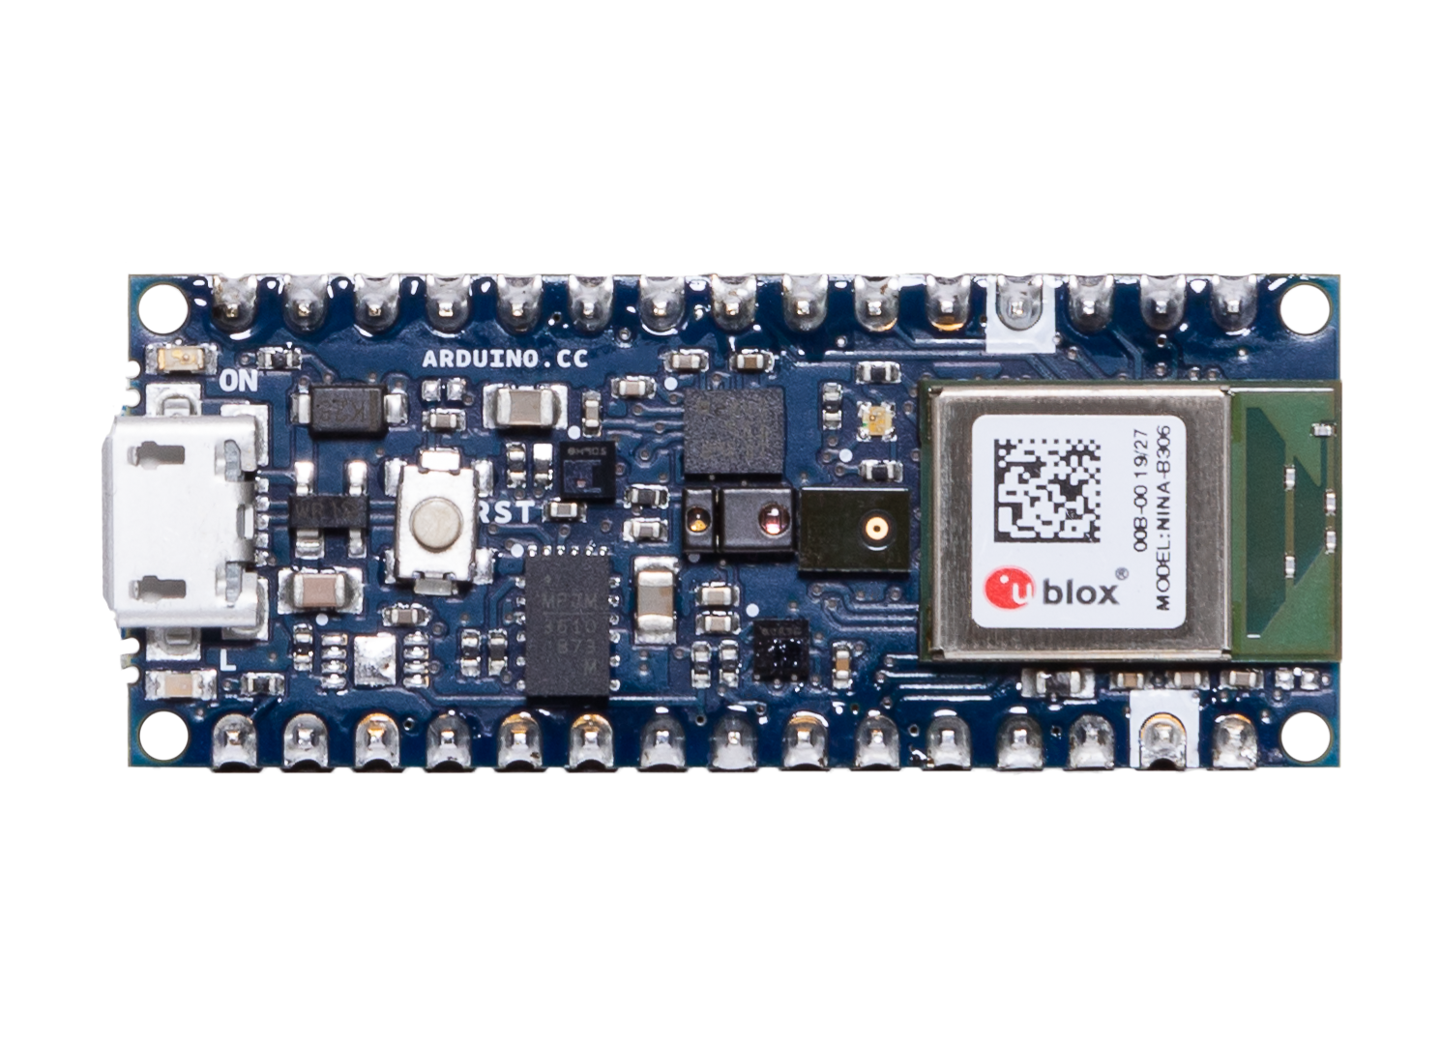
Your Embedded System

Slide 11
Your Embedded System
wifi
system
bluetooth
system
MCU
system
MediaTek 7658CSN: Wi-Fi +ARM® Cortex-R4
i/o

Slide 12
Real Embedded System
Developer Embedded Systems

Slide 13
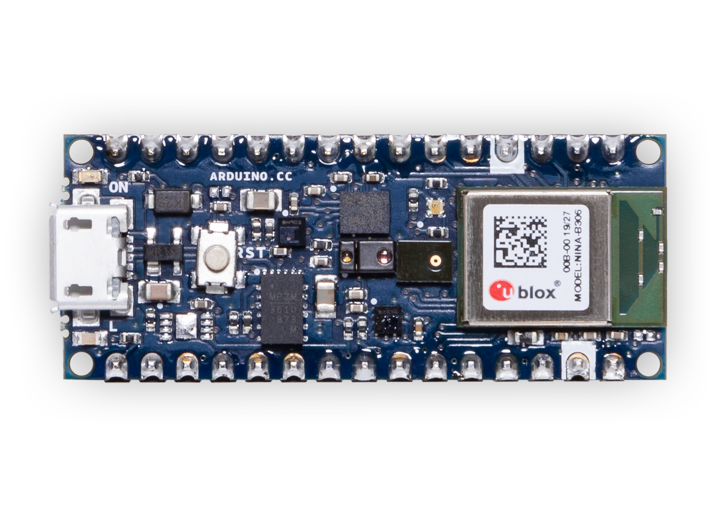
Processor
+ Bluetooth

Slide 14
Processor
+ Bluetooth
Microphone

Slide 15
IMU
Processor
+ Bluetooth
Microphone

Slide 16
IMU
Processor
+ Bluetooth
Temperature
+ Humidity
Microphone

Slide 17
IMU
I/O (USB)
Processor
+ Bluetooth
Temperature
+ Humidity
Microphone

Slide 18
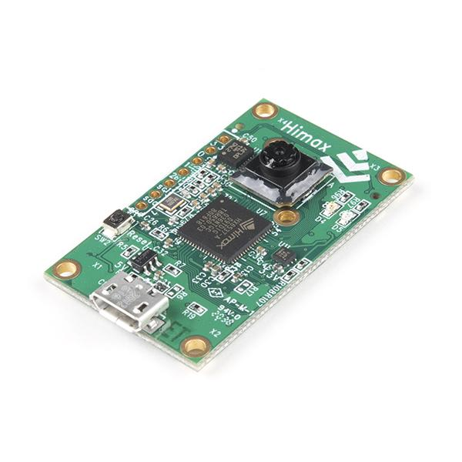
Notes:
SAY EXPLICIT PART NAME FOR FAIR OF USE IMAGE
Himax WE-I Plus EVB Endpoint AI Development Board
https://www.sparkfun.com/products/17256

Slide 19
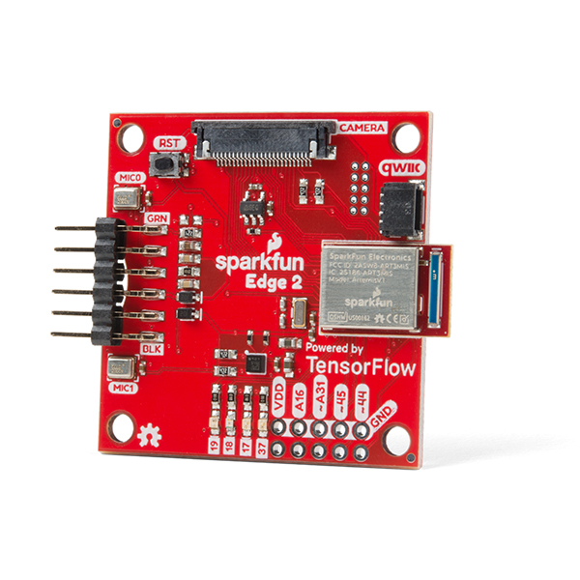
Notes:
SAY EXPLICIT PART NAME FOR FAIR OF USE IMAGE
https://www.sparkfun.com/products/retired/15420
Fair use

Slide 20
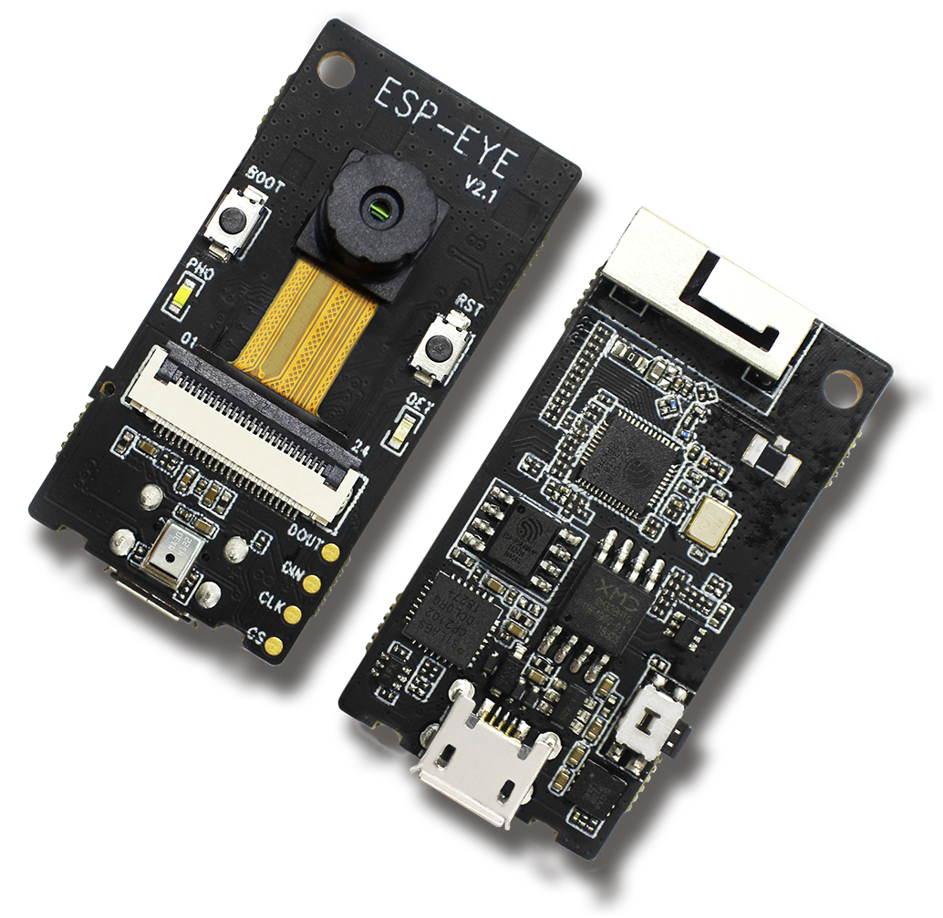
Notes:
https://www.espressif.com/en/products/devkits/esp-eye/overview
Fair use
SAY EXPLICIT PART NAME FOR FAIR OF USE IMAGE

Slide 21
Embedded Systems

Slide 22
Embedded Systems
Board | MCU / ASIC | Clock | Memory | Sensors | Radio
Himax WE-I Plus EVB | HX6537-A 32-bit EM9D DSP | 400 MHz | 2MB flash 2MB RAM | Accelerometer, Mic, Camera | None
Arduino Nano 33 BLE Sense | 32-bit nRF52840 | 64 MHz | 1MB flash 256kB RAM | Mic, IMU, Temp, Humidity, Gesture, Pressure, Proximity, Brightness, Color | BLE
SparkFun Edge 2 | 32-bit ArtemisV1 | 48 MHz | 1MB flash 384kB RAM | Accelerometer, Mic, Camera | BLE
Espressif EYE | 32-bit ESP32-D0WD | 240 MHz | 4MB flash 520kB RAM | Mic, Camera | WiFi, BLE

Slide 23
Embedded Systems
Board | MCU / ASIC | Clock | Memory | Sensors | Radio
Himax WE-I Plus EVB | HX6537-A 32-bit EM9D DSP | 400 MHz | 2MB flash 2MB RAM | Accelerometer, Mic, Camera | None
Arduino Nano 33 BLE Sense | 32-bit nRF52840 | 64 MHz | 1MB flash 256kB RAM | Mic, IMU, Temp, Humidity, Gesture, Pressure, Proximity, Brightness, Color | BLE
SparkFun Edge 2 | 32-bit ArtemisV1 | 48 MHz | 1MB flash 384kB RAM | Accelerometer, Mic, Camera | BLE
Espressif EYE | 32-bit ESP32-D0WD | 240 MHz | 4MB flash 520kB RAM | Mic, Camera | WiFi, BLE

Slide 24
Embedded Systems
Board | MCU / ASIC | Clock | Memory | Sensors | Radio
Himax WE-I Plus EVB | HX6537-A 32-bit EM9D DSP | 400 MHz | 2MB flash 2MB RAM | Accelerometer, Mic, Camera | None
Arduino Nano 33 BLE Sense | 32-bit nRF52840 | 64 MHz | 1MB flash 256kB RAM | Mic, IMU, Temp, Humidity, Gesture, Pressure, Proximity, Brightness, Color | BLE
SparkFun Edge 2 | 32-bit ArtemisV1 | 48 MHz | 1MB flash 384kB RAM | Accelerometer, Mic, Camera | BLE
Espressif EYE | 32-bit ESP32-D0WD | 240 MHz | 4MB flash 520kB RAM | Mic, Camera | WiFi, BLE

Slide 25
Embedded Systems
Board | MCU / ASIC | Clock | Memory | Sensors | Radio
Himax WE-I Plus EVB | HX6537-A 32-bit EM9D DSP | 400 MHz | 2MB flash 2MB RAM | Accelerometer, Mic, Camera | None
Arduino Nano 33 BLE Sense | 32-bit nRF52840 | 64 MHz | 1MB flash 256kB RAM | Mic, IMU, Temp, Humidity, Gesture, Pressure, Proximity, Brightness, Color | BLE
SparkFun Edge 2 | 32-bit ArtemisV1 | 48 MHz | 1MB flash 384kB RAM | Accelerometer, Mic, Camera | BLE
Espressif EYE | 32-bit ESP32-D0WD | 240 MHz | 4MB flash 520kB RAM | Mic, Camera | WiFi, BLE

Slide 26
Embedded Systems
Board | MCU / ASIC | Clock | Memory | Sensors | Radio
Himax WE-I Plus EVB | HX6537-A 32-bit EM9D DSP | 400 MHz | 2MB flash 2MB RAM | Accelerometer, Mic, Camera | None
Arduino Nano 33 BLE Sense | 32-bit nRF52840 | 64 MHz | 1MB flash 256kB RAM | Mic, IMU, Temp, Humidity, Gesture, Pressure, Proximity, Brightness, Color | BLE
SparkFun Edge 2 | 32-bit ArtemisV1 | 48 MHz | 1MB flash 384kB RAM | Accelerometer, Mic, Camera | BLE
Espressif EYE | 32-bit ESP32-D0WD | 240 MHz | 4MB flash 520kB RAM | Mic, Camera | WiFi, BLE

